Slide 1
Amani initiative profile
“Together We Can Make a Difference”

Slide 2
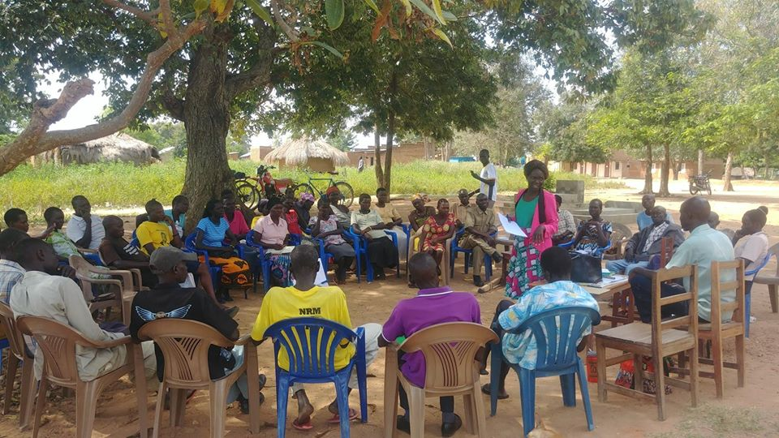
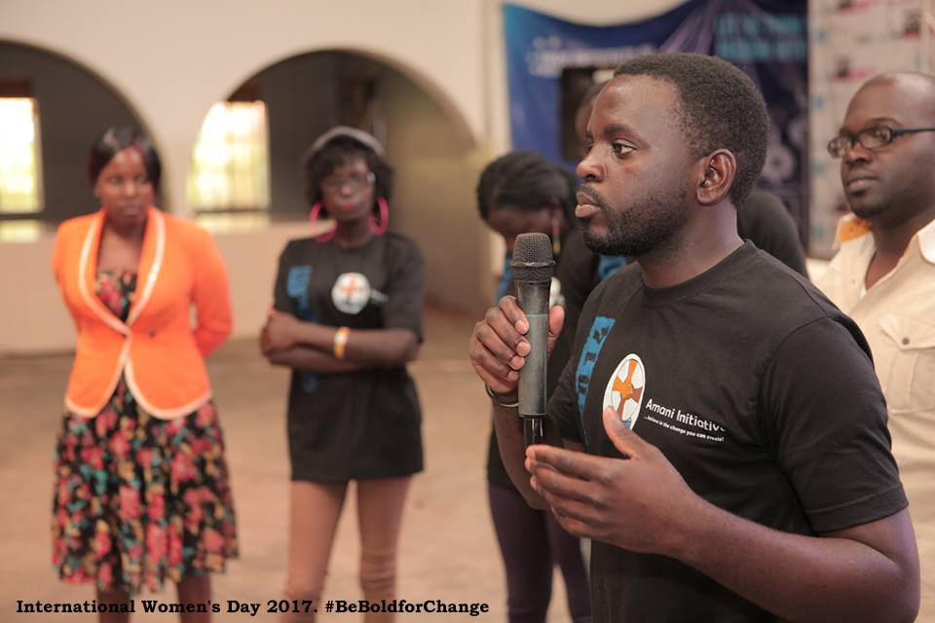
WHO WE ARE
Amani Initiative is a Ugandan Non-Governmental Organization founded in 2011 within Maracha District to prevent and respond to teenage pregnancy and child marriage through low cost-high impact community led solutions.
We are registered with the National NGO Bureau and Uganda Registration Services Bureau (URSB).
We are currently operating with a focus on West Nile, Acholi, East Central and Central Sub-Regions of Uganda.
Our Vision
“A society free from child marriage and teenage pregnancy.”
Our Mission
“To prevent and respond to teenage pregnancy and child marriage through low cost-high impact community led solutions.”
Our Core Values
Integrity
Respect
Responsibility
Accountability

Slide 3
OUR SOLUTION APPROACH
Gender Inclusive solutions
Solutions to include both male and females for because it takes two.
Grassroots Solutions
Design and basis of solutions to be guided by the grassroot situation
Low-cost high impact solutions
Solutions need to be in position to use the limited resources for the greater good of many people.
Community-led solutions
Community directly involved in the design, implementation and monitoring of solutions

Slide 4
OUR THEMATIC AREAS
EDUCATION
What we do:-
Support low cost schools to provide equal and quality education opportunities for both boys and girls.
SEXUAL & REPRODUCTIVE HEALTH
CHILD PROTECTION AND SAFEGUARDING
SOCIOECONOMIC EMPOWERMENT
What we do:-
. Financial literacy and entrepreneurship skills training for households and youth.
- Provision of low cost- business start up financing to vulnerable members of the community
- Developing of digital systems to improve effectives of village savings and loan associations.
Engages child parents and their guardians to return to school through counseling and school fees bursaries.
Recognize and award best performing learners to motivate them to study hard.
What we do:-
Engaging child mothers to access family planning services and information
What we do:-
Community dialogues and radio talk shows on prevention and response to child abuse with a focus on laws, reporting, prevention and response.
Sexual & Reproductive sensitizations to youth, households and communities with a focus on family planning, relationships, menstrual hygiene and HIV/AIDs.
Supporting children abused to access justice

Slide 5
OUR PARTNERS & DONORS

Slide 6
OUR ADDRESS
Business Development Office- AGA House Mawanda Road, (Kampala) West Nile Regional Office- Arua Youth One Stop Centre (Arua) Maracha Field Office- Market lane P.O.BOX 11406, Kampala Tel: +256 703 154 084/+256 784 951 295 Email: info@amaniwestnile.org Website: www.amaniwestnile.org
Amani Initiative
Amani Initiative

